Slide 1
Introduction to Database Management System (DBMS) Lovepreet Kaur Department of CSE/IT Global Group of Institutes

Slide 2
Introduction
Data :- Data is unorganised raw facts that need processing without which it is seemingly random and useless to humans . An example of data is a student’s test score.
Information :- Information is a processed, organised data presented in a given context and is useful to humans. The average score of a class is the information derived from the given data.

Slide 3
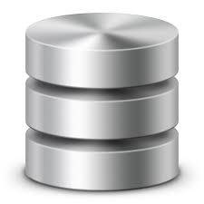
Database :- Database is a collection of inter-related data which helps in efficient retrieval, insertion and deletion of data from database and organizes the data in the form of tables, views, schemas, reports etc.
For Example, university database organizes the data about students, faculty, and admin staff etc. which helps in efficient retrieval, insertion and deletion of data from it.
Your electricity service provider is obviously using a database to manage billing , client related issues, to handle fault data, etc.
Fig. Database Icon

Slide 4
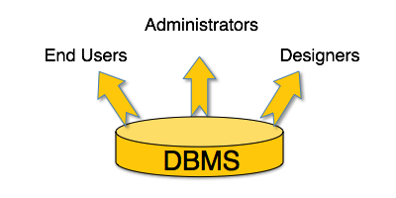
What is a Database Management System (DBMS)?
Database Management System (DBMS) is a collection of programs which enables its users to access database, manipulate data, reporting / representation of data .
It also helps to control access to the database.
DBMS allows users to create their own databases as per their requirement. The term “DBMS” includes the user of the database and other application programs. It provides an interface between the data and the software application.

Slide 5
Characteristics of Database Management System
Provides security and removes redundancy.
Support of multiple views of the data
Sharing of data and multiuser transaction processing
DBMS allows entities and relations among them to form tables.
It follows the ACID concept ( Atomicity, Consistency, Isolation, and Durability).
DBMS supports multi-user environment that allows users to access and manipulate data in parallel.

Slide 6
Users in a DBMS environment
Component Name | Task
Application Programmers | The Application programmers write programs in various programming languages to interact with databases.
Database Administrators | Database Admin is responsible for managing the entire DBMS system. He/She is called Database admin or DBA.
End-Users | The end users are the people who interact with the database management system. They conduct various operations on database like retrieving, updating, deleting, etc.

Slide 7
Applications of DBMS
Sector | Use of DBMS
Banking | For customer information, account activities, payments, deposits, loans, etc.
Airlines | For reservations and schedule information.
Universities | For student information, course registrations, colleges and grades.
Telecommunication | It helps to keep call records, monthly bills, maintaining balances, etc.

Slide 8
Advantages of DBMS
DBMS offers a variety of techniques to store & retrieve data.
Application programmers never exposed to details of data representation and storage.
A DBMS uses various powerful functions to store and retrieve data efficiently.
Offers Data Integrity and Security.
A DBMS schedules concurrent access to the data in such a manner that only one user can access the same data at a time.

Slide 9
Disadvantages of DBMS
Cost of Hardware and Software of a DBMS is quite high which increases the budget of your organization.
Most database management systems are often complex systems, so the training for users to use the DBMS is required.
In some organizations, all data is integrated into a single database which can be damaged because of electric failure or database is corrupted on the storage media
Use of the same program at a time by many users sometimes lead to the loss of some data.

Slide 10


Types of DBMS

Slide 11
Popular DBMS Software
MySQL
Microsoft Access
Oracle
PostgreSQL
dBASE
IBM DB2
LibreOffice Base
MariaDB
Microsoft SQL Server
mongoDB

Slide 12
Thanks

